Slide 1
Notes:
Layout = Holding slide A
This is a holding slide, not a title slide. This holding slide is what the audience sees while you are trying to get yourself ready. This is the presentation equivalent of a book cover. There are 3 options for your holding slide. Choose the one that you like best and has the vibe you’re going for.
The images can be changed to as need be. To do this, follow these easy instructions: 1. Click on the image
2. Click on the “Format picture” tab
3. Click on the “Change picture” button
4. Choose the new image from it’s location
5. Scale (holding shift key) as needed
Use wisely. Scale wisely.

Slide 2
Introduction to Containers
Aaron Wells – Indiana University
DevOps System / Cloud Administrator
Presented by Rob Quick
STEP1 Program – Miami, FL – 19 May 2025
Notes:
Layout = Title Slide Light
This is a true title slide. Use this slide as you are introducing yourself. Because my title is relatively short, I’ve increased the line spacing on my text block. If your title is long (Craig Stewart comes to mind), keep the line spacing as the template is constructed. It will fit better.

Slide 3
What are containers?
Born from a simple idea (chroot)
Evolved over time into various forms of container services (e.g. BSD Jails, Solaris Zones)
LXC (LinuX Containers) was released in 2008
Docker came on the scene in 2013
Other technologies evolved – Shifter, CharlieCloud, Singularity
Upping the ante – Docker Compose and container orchestration
Notes:
Chroot is an operation that changes the apparent root directory for the current running process and their children. A program that is run in such a modified environment cannot access files and commands outside that environmental directory tree. This modified environment is called a chroot jail.
It gives a user a way to run something in an isolated, controlled environment that can’t interfere with the host environment
----
The evolution of services started showing features that included external access controls and snapshots (see products like Linux VServer, Solaris Containers, OpenVZ, Process Containers by Google)
---
LXC is the first linux container system that didn’t require kernel patches – was the original basis for Docker
--
Docker really made containers popular – a combination of the right tool at the right time, ease of use, and good marketing. Biggest potential downside of Docker is the need to run as root – obviously HPC isn’t going to let you do that ☺
--
Primarily going to look at Singularity as a means of using containers in HPC – but good to know the others. Born out of the desire to run containers in a secure manner, where the user won’t have privileged access like HPC. CharlieCloud was developed at Los Alamos National Lab as a way to use containers is a very strict security environment. Shifter was born from Docker code as a project between NERSC and Cray to scale containers in HPC workloads. Many of the concepts we discuss with Singularity may apply to the others.
--
Docker Compose is all about managing and using multiple Docker apps. Container orchestration, whether it’s Docker Swarm, Apache Mesos, or Kubernetes – it’s all about managing the life cycle and work loads of containers – basically being a scheduling and management system – these can use true elastic computing techniques to grow and contract depending on the workload and configuration
-→ We’re not going to cover either as part of this tutorial. If there’s interest, it may be something for a future session, though.

Slide 4
…and why would I want to use one
Consistency**
Portability**
Ability to package and run on HPC
“Just in time” instantiation and updating on the fly
Creating microservices
Run legacy code/obsolete OSes
Reproducible Science!
**Only on same arch (x64 vs aarch)
Notes:
Consistency – the same software stack exists – the same revisions in the same configuration, each and every time
Portability – you can easily move it from place to place – done properly, the size of containers can be controlled
JIT – fast “boot” – ready almost immediately and easily dismissed, easily updated and redeployed
Small, purpose-built containers that have a single (or at least uncomplicated function) – these can be easily maintained and changed as needed without needing to redo the entire stack
Good to note – simple vs easy → the process is simple but not always easy!

Slide 5
Containers vs. Virtual Machines
VMs:
VMs are fully contained – everything you need is there
VMs are independent of the host operating system
All OS resources and tools are available
Containers:
Compact – minimal OS parts to run, rely on host
Compact nature makes them more portable
Robust ecosystem – many pre-made containers available
Notes:
Containers – small, portable
VMs – complete package
– can run Windows VMs or Solaris VMs on Linux where as containers must match the host OS since they share kernel space
Minimal OS means that there’s far less overhead to running a container
VMs are less transportable – you can take an openstack VM to most openstack clouds, but moving between different hypervisors and in and out of commercial clouds can be a challenge where as common container technologies like Docker can run in many places with little to no effort

Slide 6
What is Docker
Docker is a container technology tool to create, deploy, and run applications
Low overhead, uses the running kernel
Lets a creator package all of the software needed to run an application in a reasonably compact and run it on any other Docker-capable machine**
Uses a client (docker) to talk over a REST API to the docker daemon (dockerd) either locally or remotely
Has a large public repository of objects (containers, images, etc) at DockerHub -- and other repos are available
It allows users to develop applications, package (ship) them into containers which can then be deployed anywhere
** Even Windows and Mac!
Notes:
As noted, originally based on LXC thought it has since parted ways from that original architecture and has since created their own code base.
The kernel usage is what makes it both light but also potentially dangerous – you’re not truly isolated from the host like you would be in a virtual machine.
Windows and Mac package a small hypervisor in the Docker distribution – so you’re actually running a Linux virtual machine to run Docker containers

Slide 7
Docker in action…the big picture:
Notes:
Using the docker client to pull images (a read-only template with instructions for creating a Docker container) from a registry (DockerHub by default) – other public registries are available and you can set up private ones, as well
Key concept – images vs containers
Images are a read-only template for creating a Docker container – basically a snapshot of a container
Containers are a runnable instance of an image

Slide 8
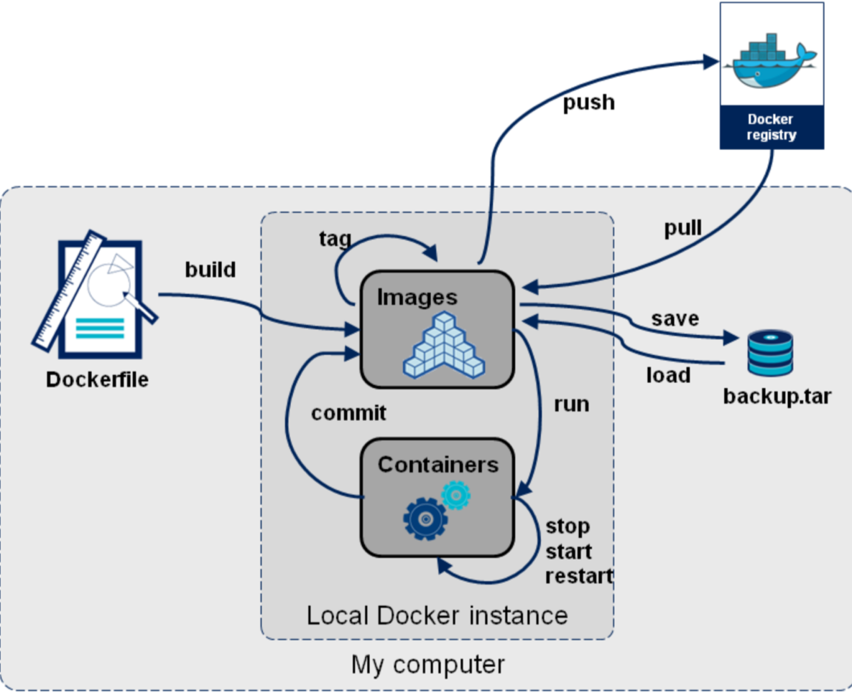
How is Docker used ?
Notes:
Registry is usually/often DockerHub
Registries can be public or private
Dockerfile – text file with all of the instructions for pulling an image, updating it, adding users, etc

Slide 9
Moving into the first exercise…
Simple container creation!
Questions?
Sign up!
https://hub.docker.com

Slide 10
labs.play-with-docker.com

Slide 11
Docker first steps
$ docker --version
Docker version 26.1.1, build 4cf5afa
$ docker pull hello-world
$ docker run hello-world
Hello from Docker!

Slide 12
Docker Core Commands!
Too many to list always refer to docker --help.
A few that we’ll use
Docker images
Docker ps
Docker run
Docker inspect
Docker build
Docker volume
Docker network

Slide 13
Docker Vocab Refresher
Images
Immutable package of binaries, files, libs and configurations to run a container.
Containers
Isolated processes, minimal influence on host and each other.
Most of the time you want to spawn a new container. If you want to make changes, build a new image.
Pets vs Cattle
Treat containers like cattle, new image, new container.
Tags!:latest
Tags are typically used to describe the version of the image. v1, v2, v3.
These are arbitrary, you can tag an image whatever you want
Check the image repository, most images have a readme with their tags.

Slide 14
Running prebuilt images
$ docker run alpine ls --l
Unable to find image 'alpine:latest' locally
124c7d270790: Download complete
b5a5b7ce4eab: Download complete
51e60588ff2c: Download complete
total 56
drwxr-xr-x 2 root root 4096 Mar 29 14:46 bin
drwxr-xr-x 5 root root 340 May 8 22:58 dev
drwxr-xr-x 1 root root 4096 May 8 22:58 etc
drwxr-xr-x 2 root root 4096 Mar 29 14:46 home

Slide 15
Working with prebuilt images
$ docker images
REPOSITORY TAG IMAGE ID CREATED SIZE
Hello-world. latest 9eabfcf60346 3 days ago 24.1kB
$ docker ps -a
ID IMAGE COMMAND CREATED STATUS
93e6d5d alpine "ls -l" 10 minutes ago Exited (0) 10 minutes ago
$ docker run -it alpine
Notes:
Docker images
This shows you all of the images you have downloaded as well as what tag you have, when you downloaded them and what size
docker ps
This will show you what containers are currently running
docker ps -a
This shows you all containers even exited containers
docker run -it alpine
This will drop you into a shell on the container, allows you to examine the structure of the container while it’s running.

Slide 16
Docker layers!
All containers run from a base filesystem with some metadata (Container Image).
Each instruction is a layer.
When you build an image the builder attempts to reuse the cached layer.
Tips!
Try to combine package manager commands in the same command.
Install software dependences before you copy over the application/files.
You can view the history of an image with the docker history <image name> command.

Slide 17
Building your Image
Let’s build a simple static web page container!
$ git clone git@github.com:access-ci-org/Operation_STEP.git
$ cd Operation_STEP/Day6-May22/02-Containers/Exercises/Hello_World

Slide 18
Building your Image
index.html
<html>
<title>Congrats!</title>
<body>
<h1>Hello World!</h1>
<p>Hello everyone, This is running via Docker container</p>
</div>
</body>
</html>
Dockerfile
# this is the base image
FROM nginx:stable-alpine
# this copies index.html into the /usr/share/nginx/html directory in the container
COPY index.html /usr/share/nginx/html/
# this tells the container to expose port 80
EXPOSE 80

Slide 19
Building your container
$ docker build -t day6-($USERNAME)-hello-world .
This will build your docker container and call it day6-(Your username here)-hello-world
$ docker run -d -p 8080:80 day6-($USERNAME)-hello-world
This runs your image and binds local port 8080 (of your laptop/vm) to the container’s port 80. If you are using a shared vm, then you’ll need to change 8080 to another port.
$ curl localhost:$PORT
Notes:
Important to mention the . at the end, it builds in the current directory
Might need to check and make sure that folks are in the directory with the Dockerfile

Slide 20
Building an Image with a python app builtin
$ cd Operation_STEP/Day6-May22/02-Containers/Exercises/Dice_Roll
$ docker build -t day6-YOUR ACCESS USERNAME HERE-dice-roll .
$ docker run day6-YOUR ACCESS USERNAME HERE-dice-roll
This will print out 1d6 until you hit CTRL+C
diceroll.py
from random import randint
import time
repeat_rolling = True
while repeat_rolling:
print("You rolled the following number using the Dice -",randint(1,6))
time.sleep(1)

Slide 21
Stopping containers
$ docker ps
$ docker stop $containerID(s)

Slide 22
Docker Compose
What is it?
Tool for defining and running multi-container applications
Allows you to specify services, networks, volumes, all in a single (or multiple!) YAML (Yet Another Markup Language) file(s)
Also allows you control the whole lifecycle of your application from one tool
Exercise Time!
Git clone the repo below and navigate to nextcloud-redis-mariadb
Let’s talk about volumes and networks next!
https://github.com/docker/awesome-compose/
Notes:
Computing components of an application are defined as services. A service is an abstract concept implemented on platforms by running the same container image, and configuration, one or more times.
Services communicate with each other through networks. In the Compose Specification, a network is a platform capability abstraction to establish an IP route between containers within services connected together.
Services store and share persistent data into volumes. The Specification describes such a persistent data as a high-level filesystem mount with global options.
Nextcloud is a self hosted file sharing, office documention, good example for this demo since it running three containers with volumes, and networks.
Apache as the web front end, redis as the kv store and cache layer, and mariadb as the storage backend.

Slide 23
Docker Volumes
Volumes are a way of persisting data for a container, such as a db.
They live outside the container and are mounted by docker inside the container.
Can be mounted by multiple containers at the same time.
docker volume ls
Look at the compose.yaml file
How many volumes do you see?
Note how many and then check after we do a docker compose up -d

Slide 24
Docker Networks
Container network is enabled by default, no need to configure it.
All containers can send outbound unless you have a hostbased firewall limiting outbound traffic.
Types of networking *Most important*
Bridge (default driver)*
Host *
Overlay
Ipvlan
Macvlan
None
Inspect some of the networks on your docker host, do they make sense? Are the containers attached where you thought they would be?
Notes:
Bridge is the default network driver. Think of it as a virtual switch on your host that containers are plugged into. The container gets an internal non-routable ip address internal to that network that will get nat’ed out in order to send traffic outside the subnet.
Any host that’s attached to the bridge network can talk to any other service that’s also attached to the same bridge network.
User defined bridge networks:
Typically you want to define your own user network to help isolate each service, in the compose example there’s no reason why then redis service needs to talk to the mysql service
Also big plus is that using a user defined network is that DNS works automagically
environment:
- REDIS_HOST=redis
- MYSQL_HOST=db
No need to specific the ip since dns will auto translate it.
Host mode networking:
Used to only work on linux based hosts, but beta feature in mac and windows now.
Binds the container directly to the port of the host based machine for improved performance.
No port mapping required since the container binds directly to exposed ports.
Overlay: Used mostly for swarms, however not the only use for it.
Ipvlan: allows a container to talk to a layer 2/3 vlan using a parent interface.
Macvlan: allows a container to talk at the mac address level of the network by creating a interface with a mac address.
None: completely isolated container.

Slide 25


Docker swarm
One docker host is nice, but what if your container needs more resources, or has the availability requirements?
Enter Docker Swarm!

Slide 26
Docker Swarm
Swarm is multiple Docker hosts running in a special mode called “Swarm”
Allows a Docker host to be a Manager, Worker or both.
Managers schedule where services and containers live and perform heartbeat checks
Workers just host containers and run services
Let’s get started.
labs.play-with-docker.com
Click the wrench and select 3 managers and 2 workers.
Docker node ls should show managers{1,2,3} and worker{1,2}
Let’s launch a service.
docker service create --name helloworld alpine ping iu.edu
docker service
Inspect the service
docker service scale up!
docker service scale down!
Notes:
# launch nginx
docker service create --name nginx --replicas 1 --publish published=8080,target=80 nginx:1.25
# scale up nginx server
docker service update --replicas 10 nginx
# update the image
docker service update --image nginx:1.26 nginx
# scale down the service
docker service update --replicas 1 nginx
# grab all the containers across the swarm
docker node ps $(docker node ls -q)

Slide 27
If you want to clean up after yourselves. docker service rm {id} docker image prune docker container prune docker network prune docker images prune
That’s all for containers!
Email: wellsaar@iu.edu ACCESS-CI Slack: wellsaar

